Slide 1
Writing PoSh Modules
With Your Trusty Friend C#
Dave Brothers

Slide 2
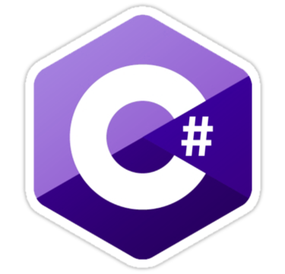
Why C#?
Why not?
Binary distribution
C# features
References

Slide 3
The Basics
System.Management.Automation
Framework Targeting
.NET 4 -> PoSh 3.0
Notes:
System.Management.Automation Docs: https://msdn.microsoft.com/en-us/library/system.management.automation%28v=vs.85%29.aspx
System.Management.Automation dir C:\Program Files (x86)\Reference Assemblies\Microsoft\WindowsPowerShell\3.0

Slide 4
The Slightly Less Basics
Class Cmdlet decoration
Verb, Noun, Named Params
PSCmdlet inheritance
Cmdlet class signature
Notes:
http://www.powershellmagazine.com/2014/03/18/writing-a-powershell-module-in-c-part-1-the-basics/

Slide 5
PSCmdlet Class Signature
BeginProcessing
Pre-processing; fires once
ProcessRecord
Fires once per fed object
EndProcessing
Post-processing; fires once
Notes:
Becasue each of these is inherited from PSCMdlet class, implement as protected overrides.

Slide 6
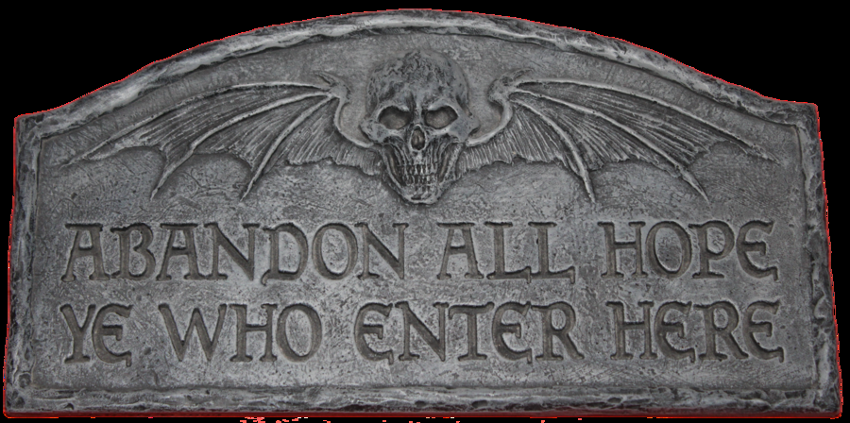
Show, Don’t Tell
Follow along at home!
https://github.com/duplicatelogon/NewHgrc
Notes:
The demo repo shows ways to import external references (in this case a parser library from a helpful Githubber) and follow the PSCmdlet signature. I made some of the choices in structure because this module is not intended to take pipeline input; if that’s your jam, you probably should make different choices. In order to fully explore facets like the package import, a full clone might be necessary.

Slide 7
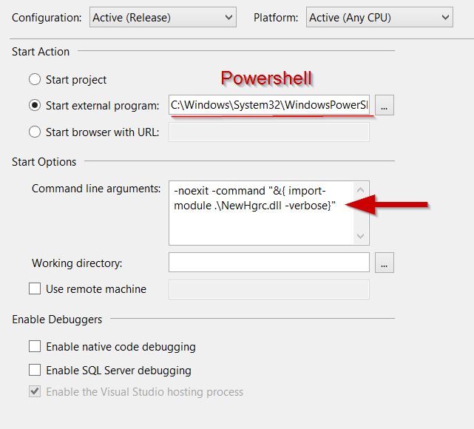
Squash Bugs
Change project props to start PoSh.exe
Use CL args to stop exit and import current module
Notes:
This only applies to commercial versions of VS. If you are using a free/Express version, attach debugger to the PoSh process.

